Slide 1
Monitoring and Recovering System for the Optimisation Process in Engineering
By: Mathieu Dutour, Miguel Martínez, Jakub Baron, Léo Raimondjean
Group Project (2014-2015)

Slide 2
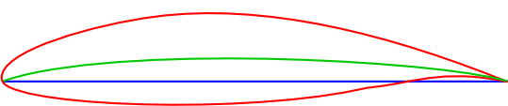
Introduction
Monitor a workflow process of a distributed system
Optimize a complex computational problem
The aim will be to enhance parameters in such a way that the drag of the aircraft is minimized while the lift is maximized

Slide 3
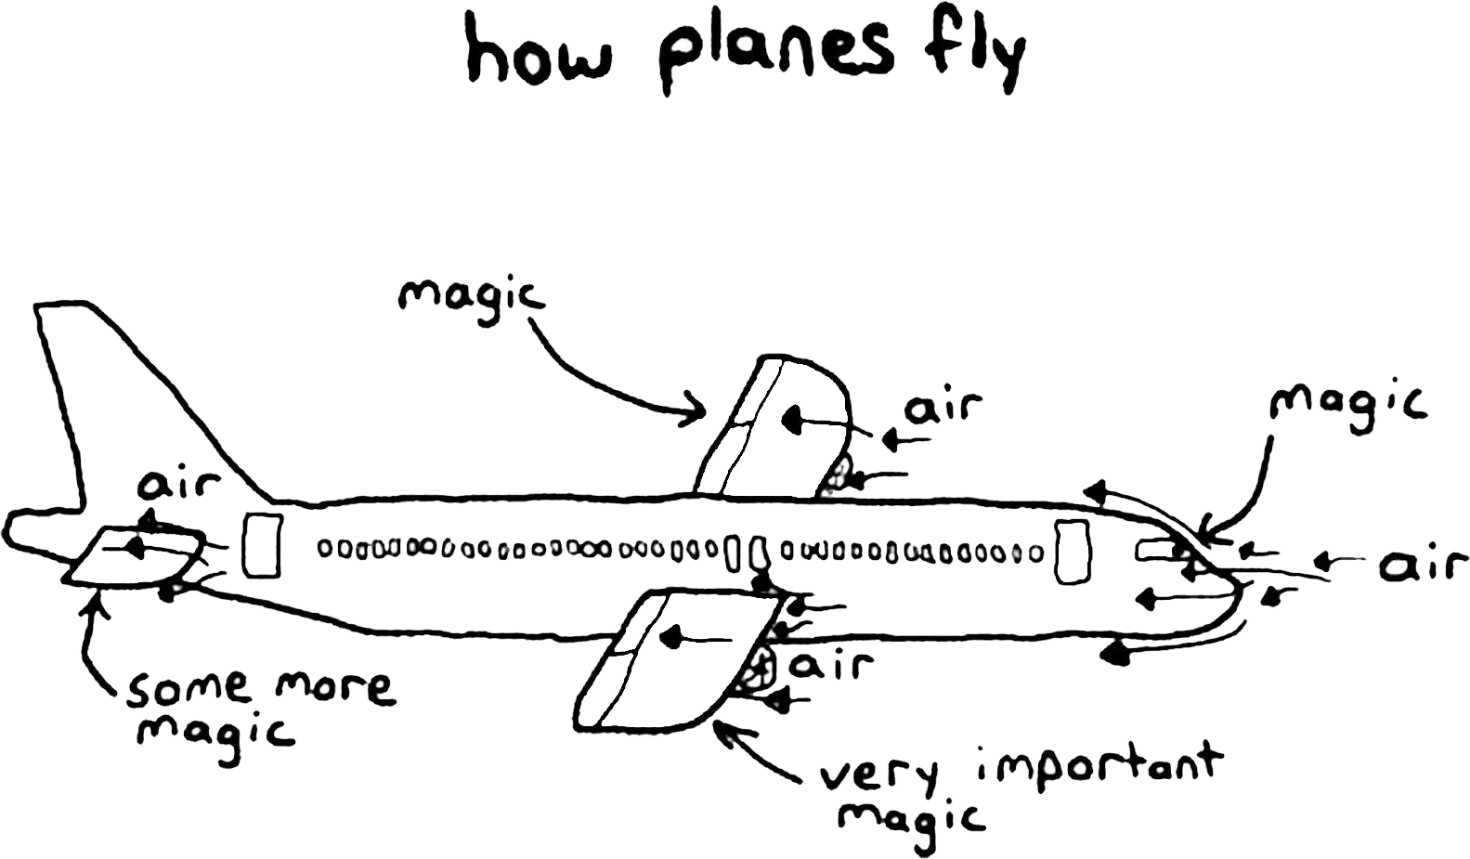
In life there are always problems…

Slide 4
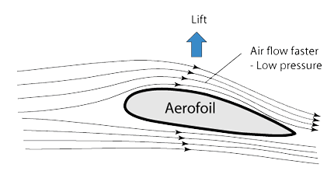
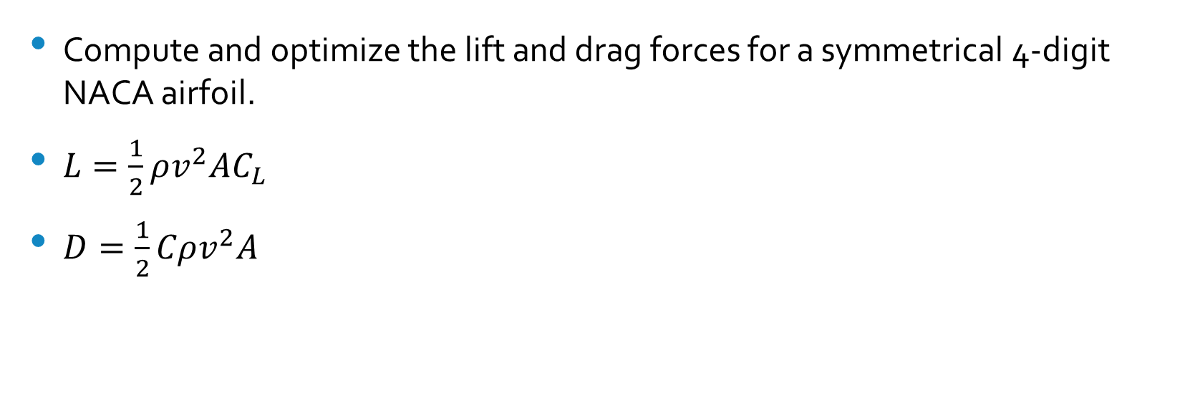
In life there are always problems…
Compute and optimize the lift and drag forces for a symmetrical 4-digit NACA airfoil.
$L=\frac{1}{2}ρv^{2}AC_{L}$
$D=\frac{1}{2}Cρv^{2}A$
Maximize
Minimize

Slide 5
Software Requirements
Functional Requirements
Non-functional Requirements
Start optimization execution
Setting up the optimization parameters
Manage previous executions
Log system events and actions
Intuitive User Interface
Low use of system resources
Secure access + authentication
Disaster recovery / Robustness
Notes:
Robustness: The system should be able to continue the calculations after the application crashes on either client or server side

Slide 6
Software Requirements
Functional Requirements
Non-functional Requirements
Optimize lift-to-drag ratio
Ability to plot the ratio over iterations
Ability to draw a sketch of the wing with the optimized parameters.
Privacy
Open-source
Portability
Backups
Notes:
Privacy: each user should have the access only to his previous computations
Open-source: The application uses open-source software
Portability: The software should remain operable on various systems
Backup: The database should be backed up regularly

Slide 7
How do we design such a system?
The software is divided into different separate modules:
Drag Solver: Solves drag equation
Lift Solver: Solves lift equation
Optimizer: Optimization procedure
Authentication: Handles user authentication
Monitor: Handles monitoring of solvers

Slide 8



Realtime + reactivity (2-way data binding)
Same code in client and server
Only data sent through wire
Latency compensation

Slide 9
Synchronized DBs
=
Seeming instant response
Realtime interaction!

Slide 10
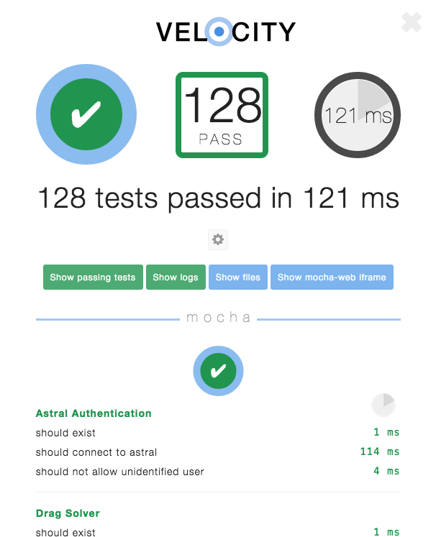
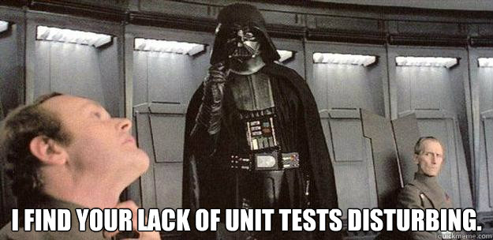
Test & Validation
Tested authentication features
Drag solver equation
Lift solver equation
More to come!

Slide 11
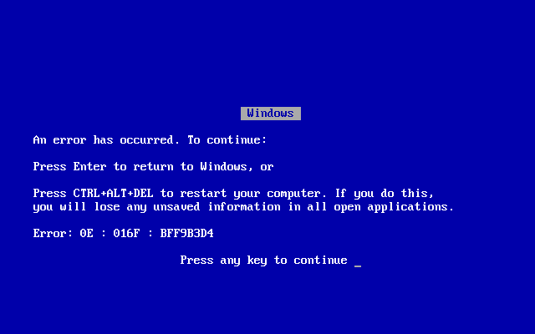
Failure Case Studies
Notes:
If server crashes, any optimization procedure in execution can be restarted from its last iteration.

Slide 12
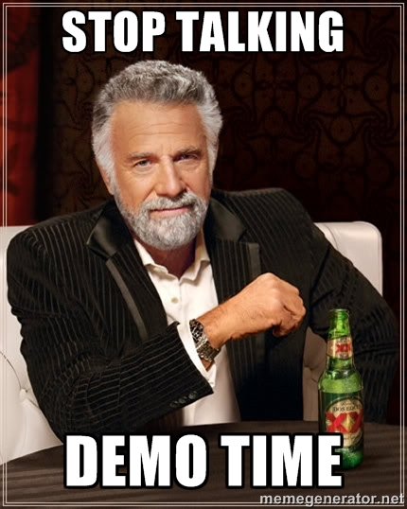
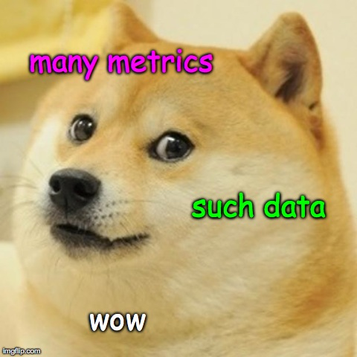
Demo time!

Slide 13

Check out the code on Github: http://github.com/mathieudutour/group-project
We welcome pull requests!
Meteor Resources: https://docs.meteor.com/
MongoDB: http://www.mongodb.org/

